Slide 1
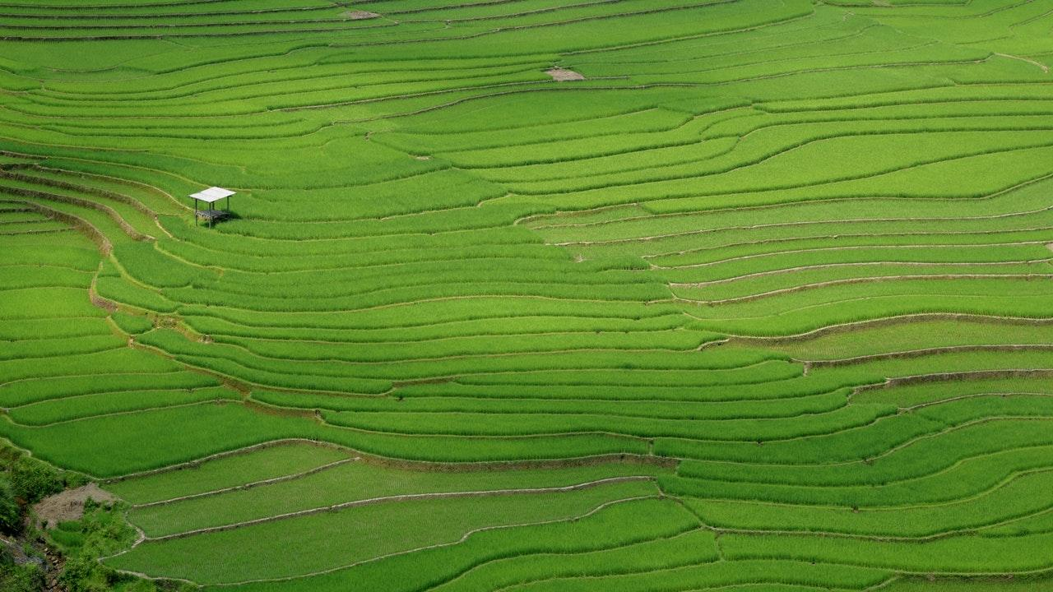
SRP ENVIRONMENTAL WEBSITE WITH PREDICTION MODELS! - Ajay.B(2018506010) Abhinav Shekar.S(2018506002) Nabeel Mohamed Sheriff(2018506068)

Slide 2
PROBLEM STATEMENT
The project deals about the various prediction models using Machine Learning algorithms. The prediction model entities to be analyzed are listed as follows: i)Rainfall prediction ii)Flood prediction iii)Stock prediction
<number>

Slide 3

INTRODUCTION
What is Global Warming and Climate Change?
Global warming and climate change refer to an increase in average global temperatures. Natural events and human activities are believed to be contributing to an increase in average global temperatures. This is caused primarily by increases in greenhouse gases such as Carbon Dioxide (CO₂).
<number>

Slide 4

Rainfall prediction
Accurate prediction of rainfall (precipitation) is challenging due to the complexity of meteorological phenomena. Rainfall is caused by a variety of meteorological conditions and the mathematical model for it is nonlinear. Weather forecasting methods based on neural networks (NNs) which are implemented on general-purpose computers, have been investigated intensively in recent years.

Slide 5
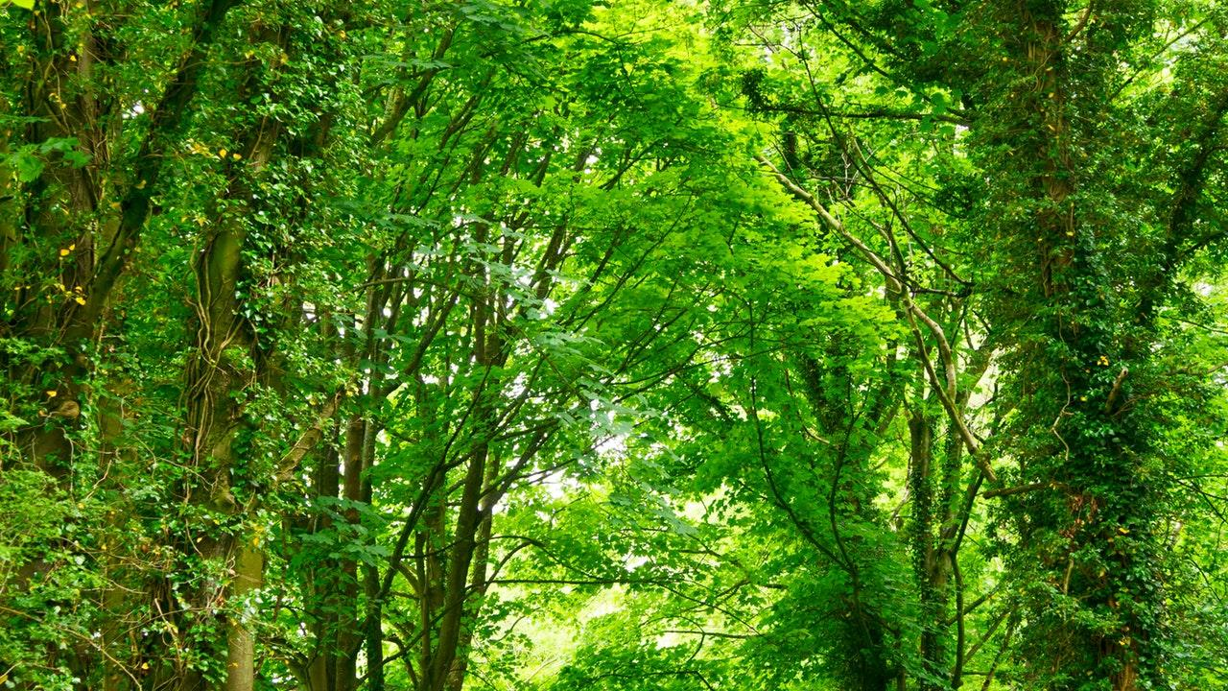
Flood Prediction
Floods may only last few hours and can cause considerable damage and a possible threat to life. Flood prediction requires quantitative knowledge about infiltration and runoff dynamics, which is generally gained at the local scale. When scaling up local measurements to the catchment scale, account needs to be taken off the catchment’s organization (connectivity and patchiness). Our study showed that the peak discharge can be significantly reduced if the succession and connectivity of land use are well planned.
<number>

Slide 6

Stock Prediction
Predicting how the stock market will perform is one of the most difficult things to do. There are so many factors involved in the prediction – physical factors vs. physhological, rational and irrational behaviour, etc. All these aspects combine to make share prices volatile and very difficult to predict with a high degree of accuracy. Machine learning techniques have the potential to unearth patterns and insights we didn’t see before, and these can be used to make unerringly accurate predictions.
<number>

Slide 7
REFERENCE PAPER ANALYSIS
https://github.com/ajai-cr7/Srp/tree/master/ResearchPapers
<number>

Slide 8
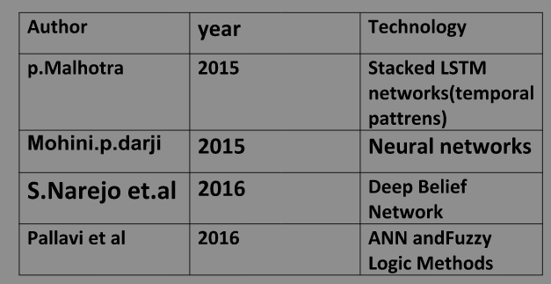
LITERATURE VIEW
<number>

Slide 9
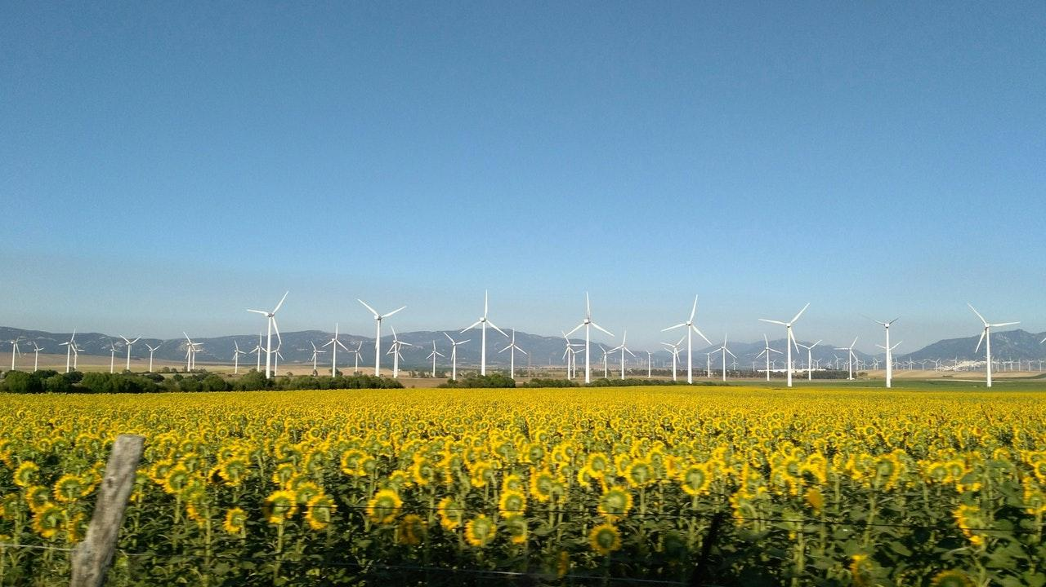
PROPOSAL
Our idea is to project the environmental websites with various prediction models.
The main feature of this project is the combination of materialistic and natural environment scenarios consisting of the rainfall prediction, flood prediction and stock prediction.
The stock prediction is included in the materialistic means of environment.
This website makes us to access these three things which is unique in the common world.
The propsal of this project has been analysed with various reference papers and implemented in our own fasion.
<number>

Slide 10
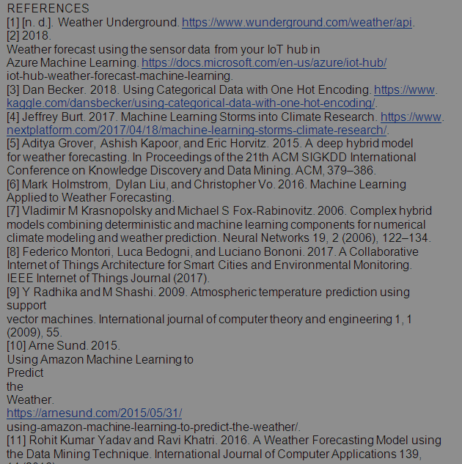
References
<number>

Slide 11
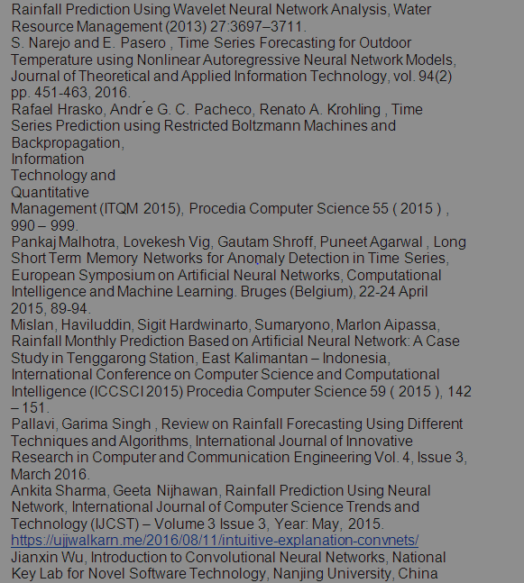
<number>

Slide 12
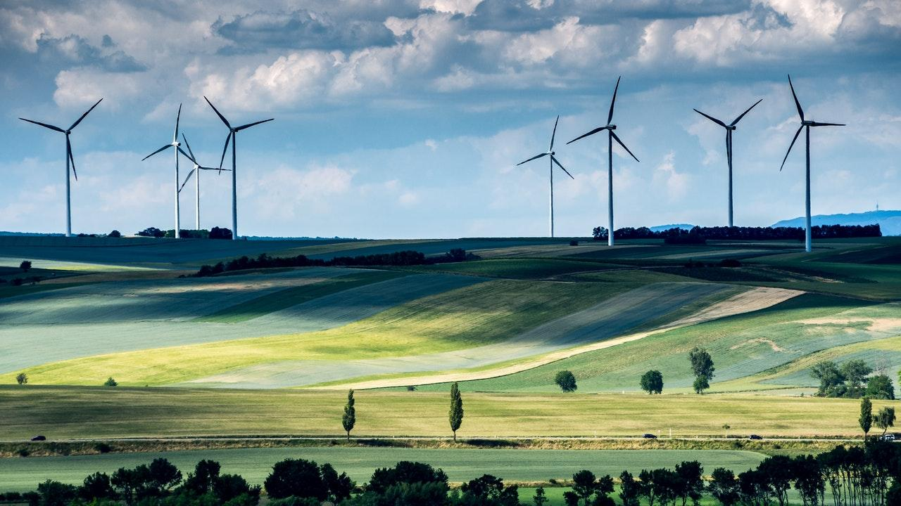
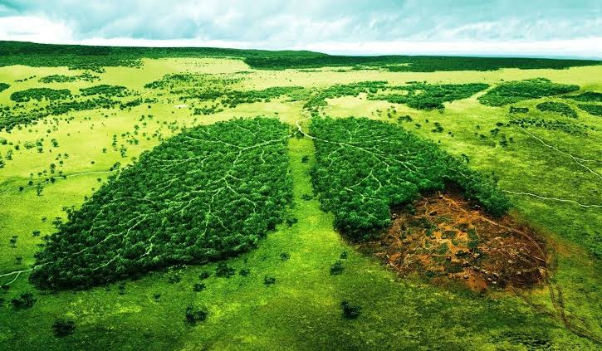
<number>

Slide 13
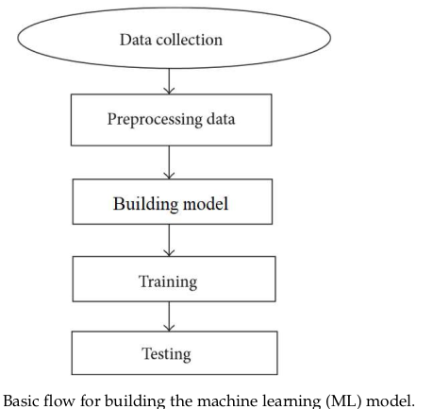
ARCHITECTURE DIAGRAMS
<number>

Slide 14

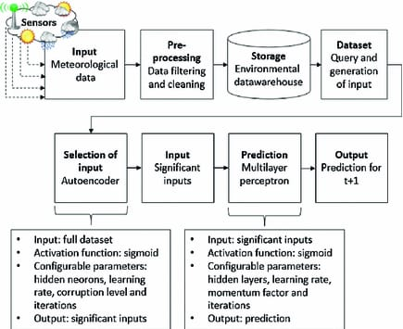
Rainfall prediction:
<number>

Slide 15
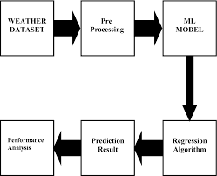
Weather prediction:
<number>

Slide 16
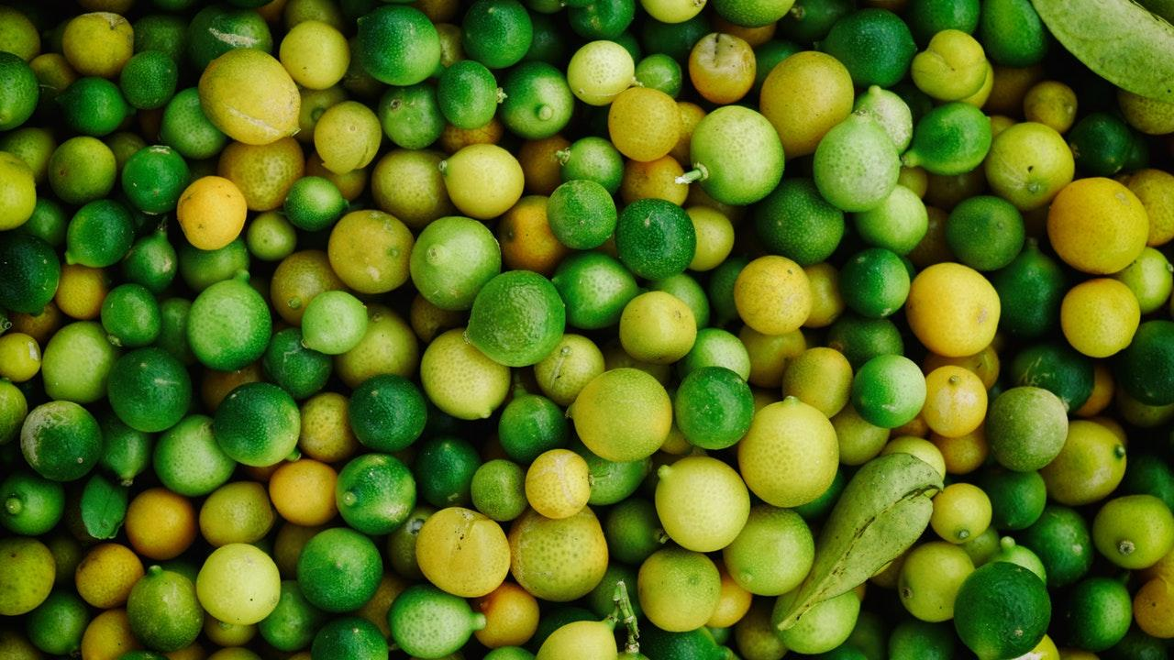
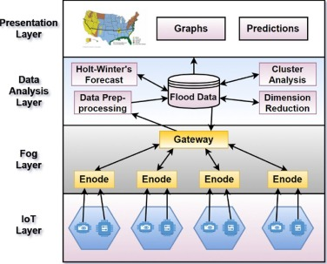
Flood prediction:
<number>

Slide 17

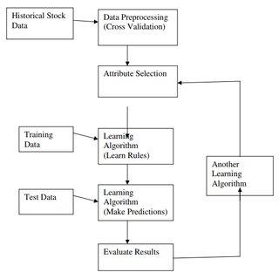
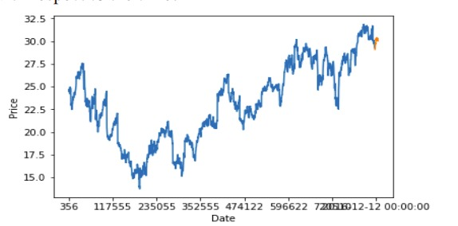
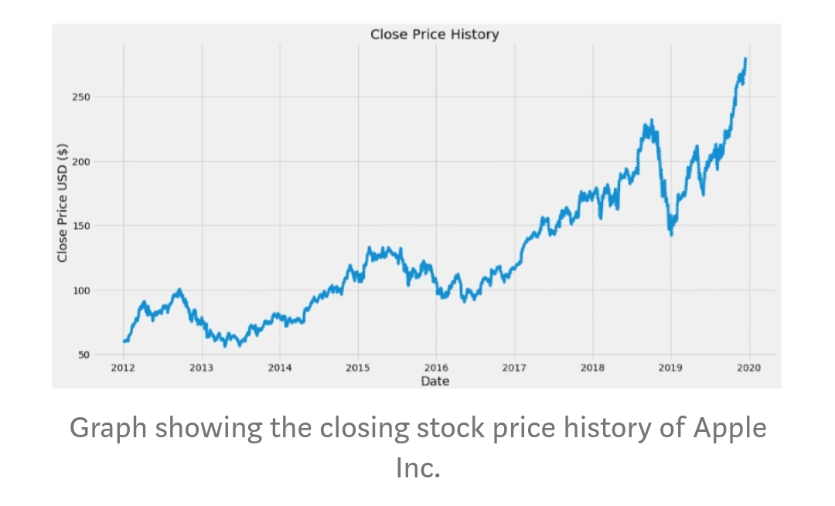
Stock prediction
<number>

Slide 18
Our planet’s alarm is going off, and it is time to wake up and take action! – Leonardo DiCaprio
<number>

Slide 19
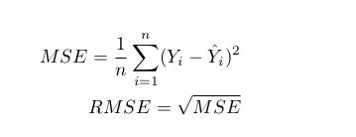
DRAWBACKS IN CURRENT PAPERS
Rainfall :
-----------
=>High RMSE (Root Mean Square Error) and MAPE (Mean Absolute Percentage error)errors so that future months are less reliable for Meteorological purposes.
=>No model for light rain scenarios !
<number>

Slide 20
Flood:
--------
=>There is no model for spatial flood prediction , that is predicting the floods in certain areas, that weren’t affected before
Stock:
--------
=>The existing system fails when there are rare outcomes or predictors,
=>The existing system does not perform well when there is a change in the operating environment.
=> It doesn‟t focus on external events in the environment, like news events or social media.
<number>

Slide 21
Weather :
------------
=>Results varies from obtained from temperature and humidity sensors and weather station data , because existing models considers only specific parameters to all areas, just like an generalised model , but an parameter in one city might also affects other cities too , like considering the atmospheric moisture !
<number>

Slide 22
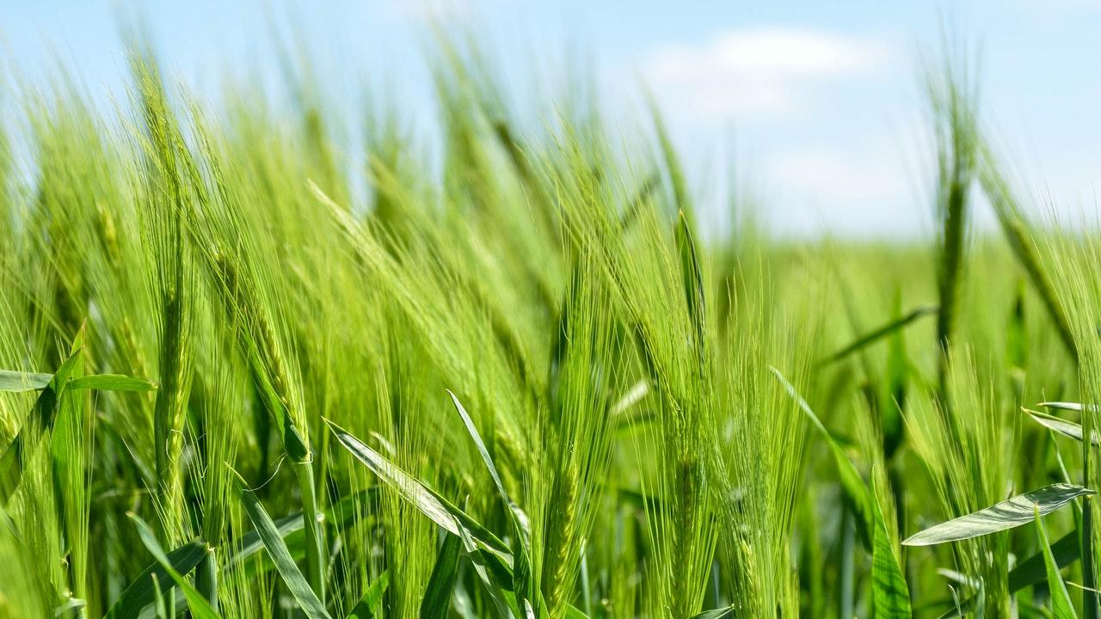
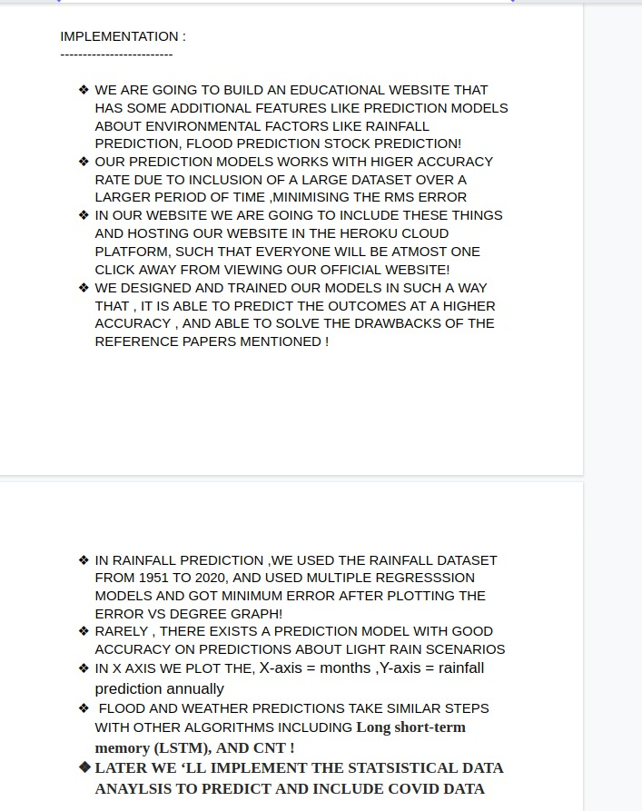
<number>

Slide 23
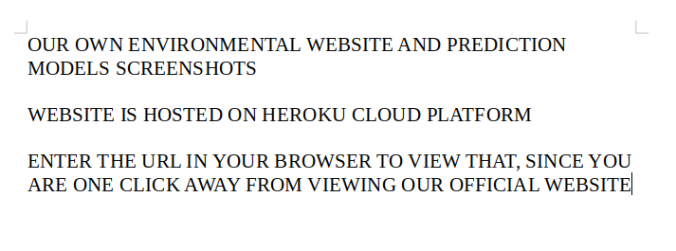
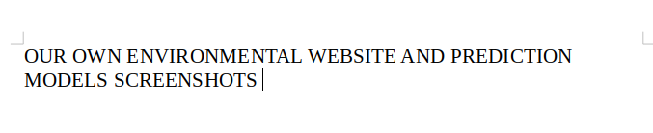

Slide 24
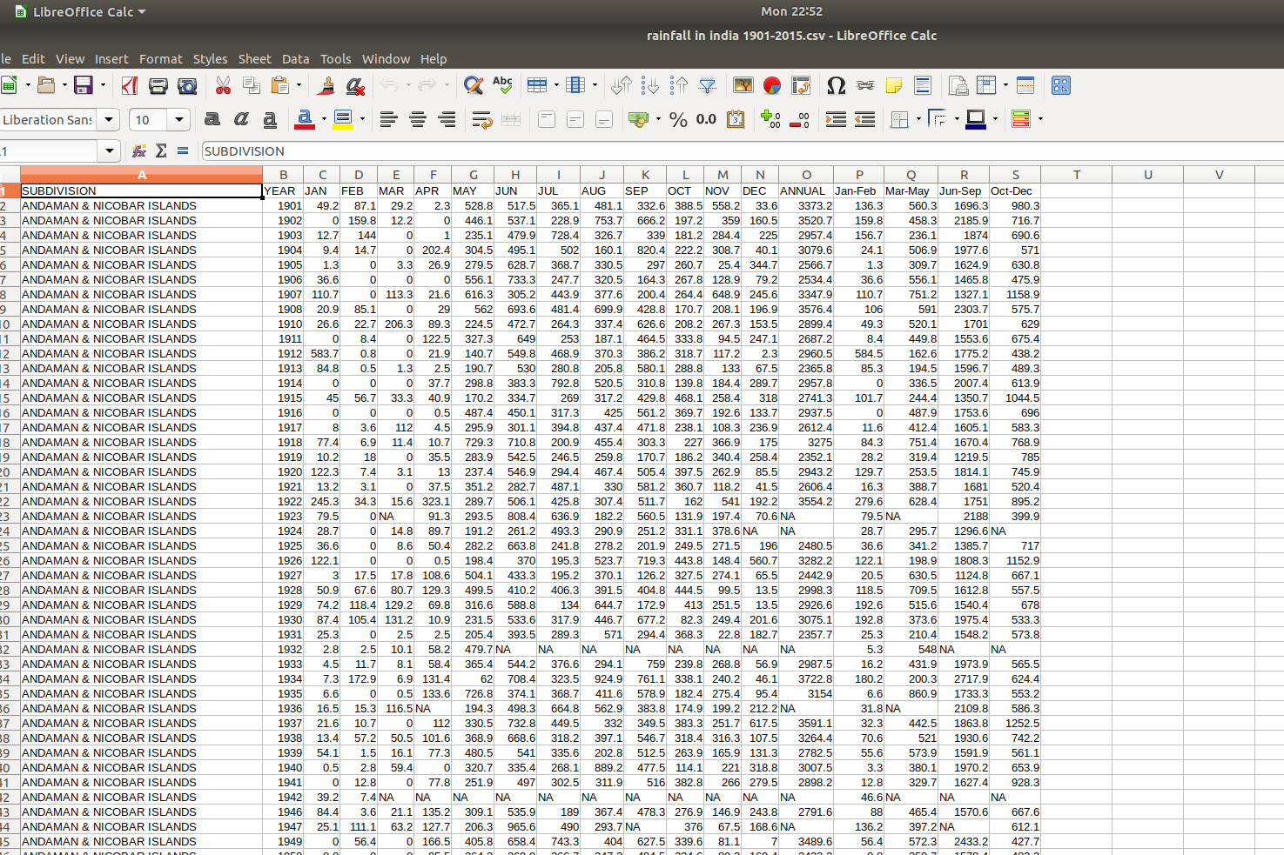

Slide 25
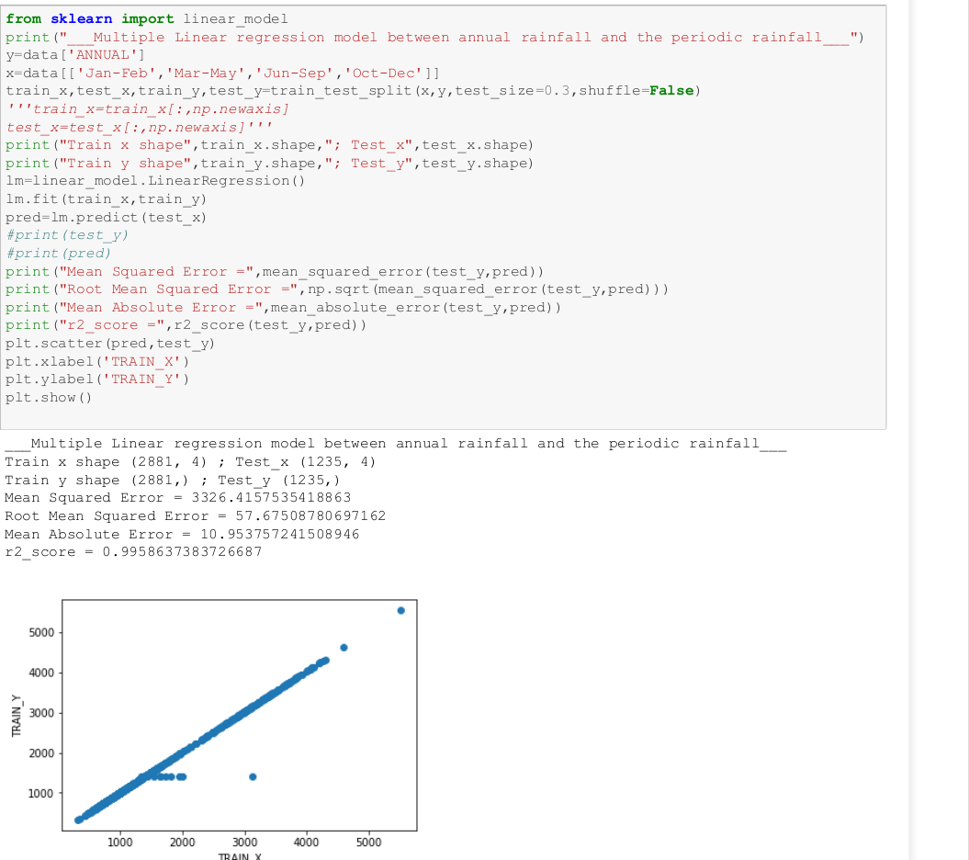

Slide 26
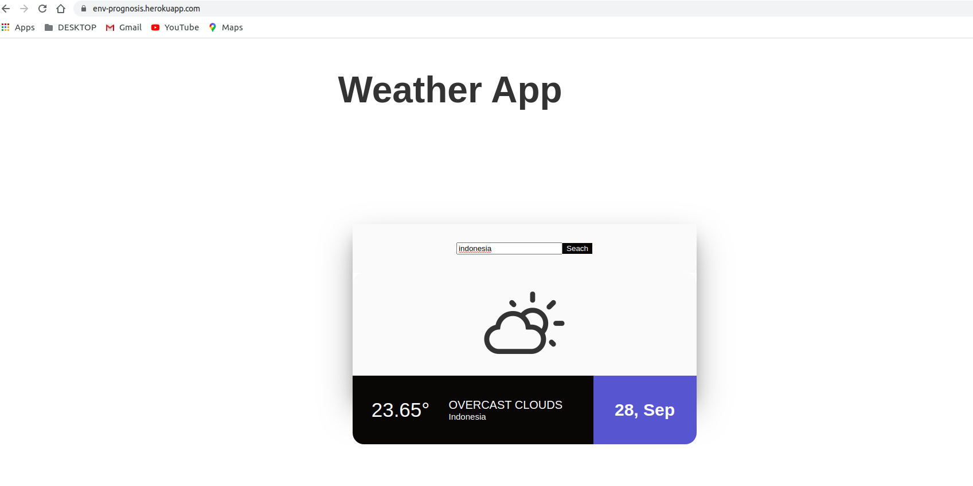

Slide 27
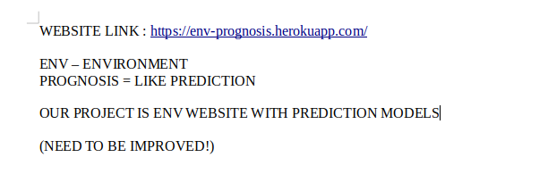
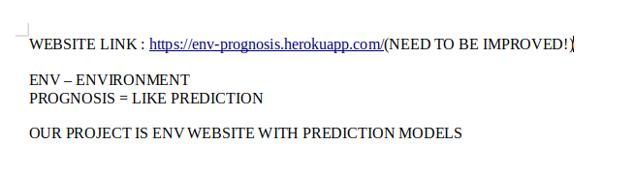

Slide 28
Thank you
<number>

